Slide 1
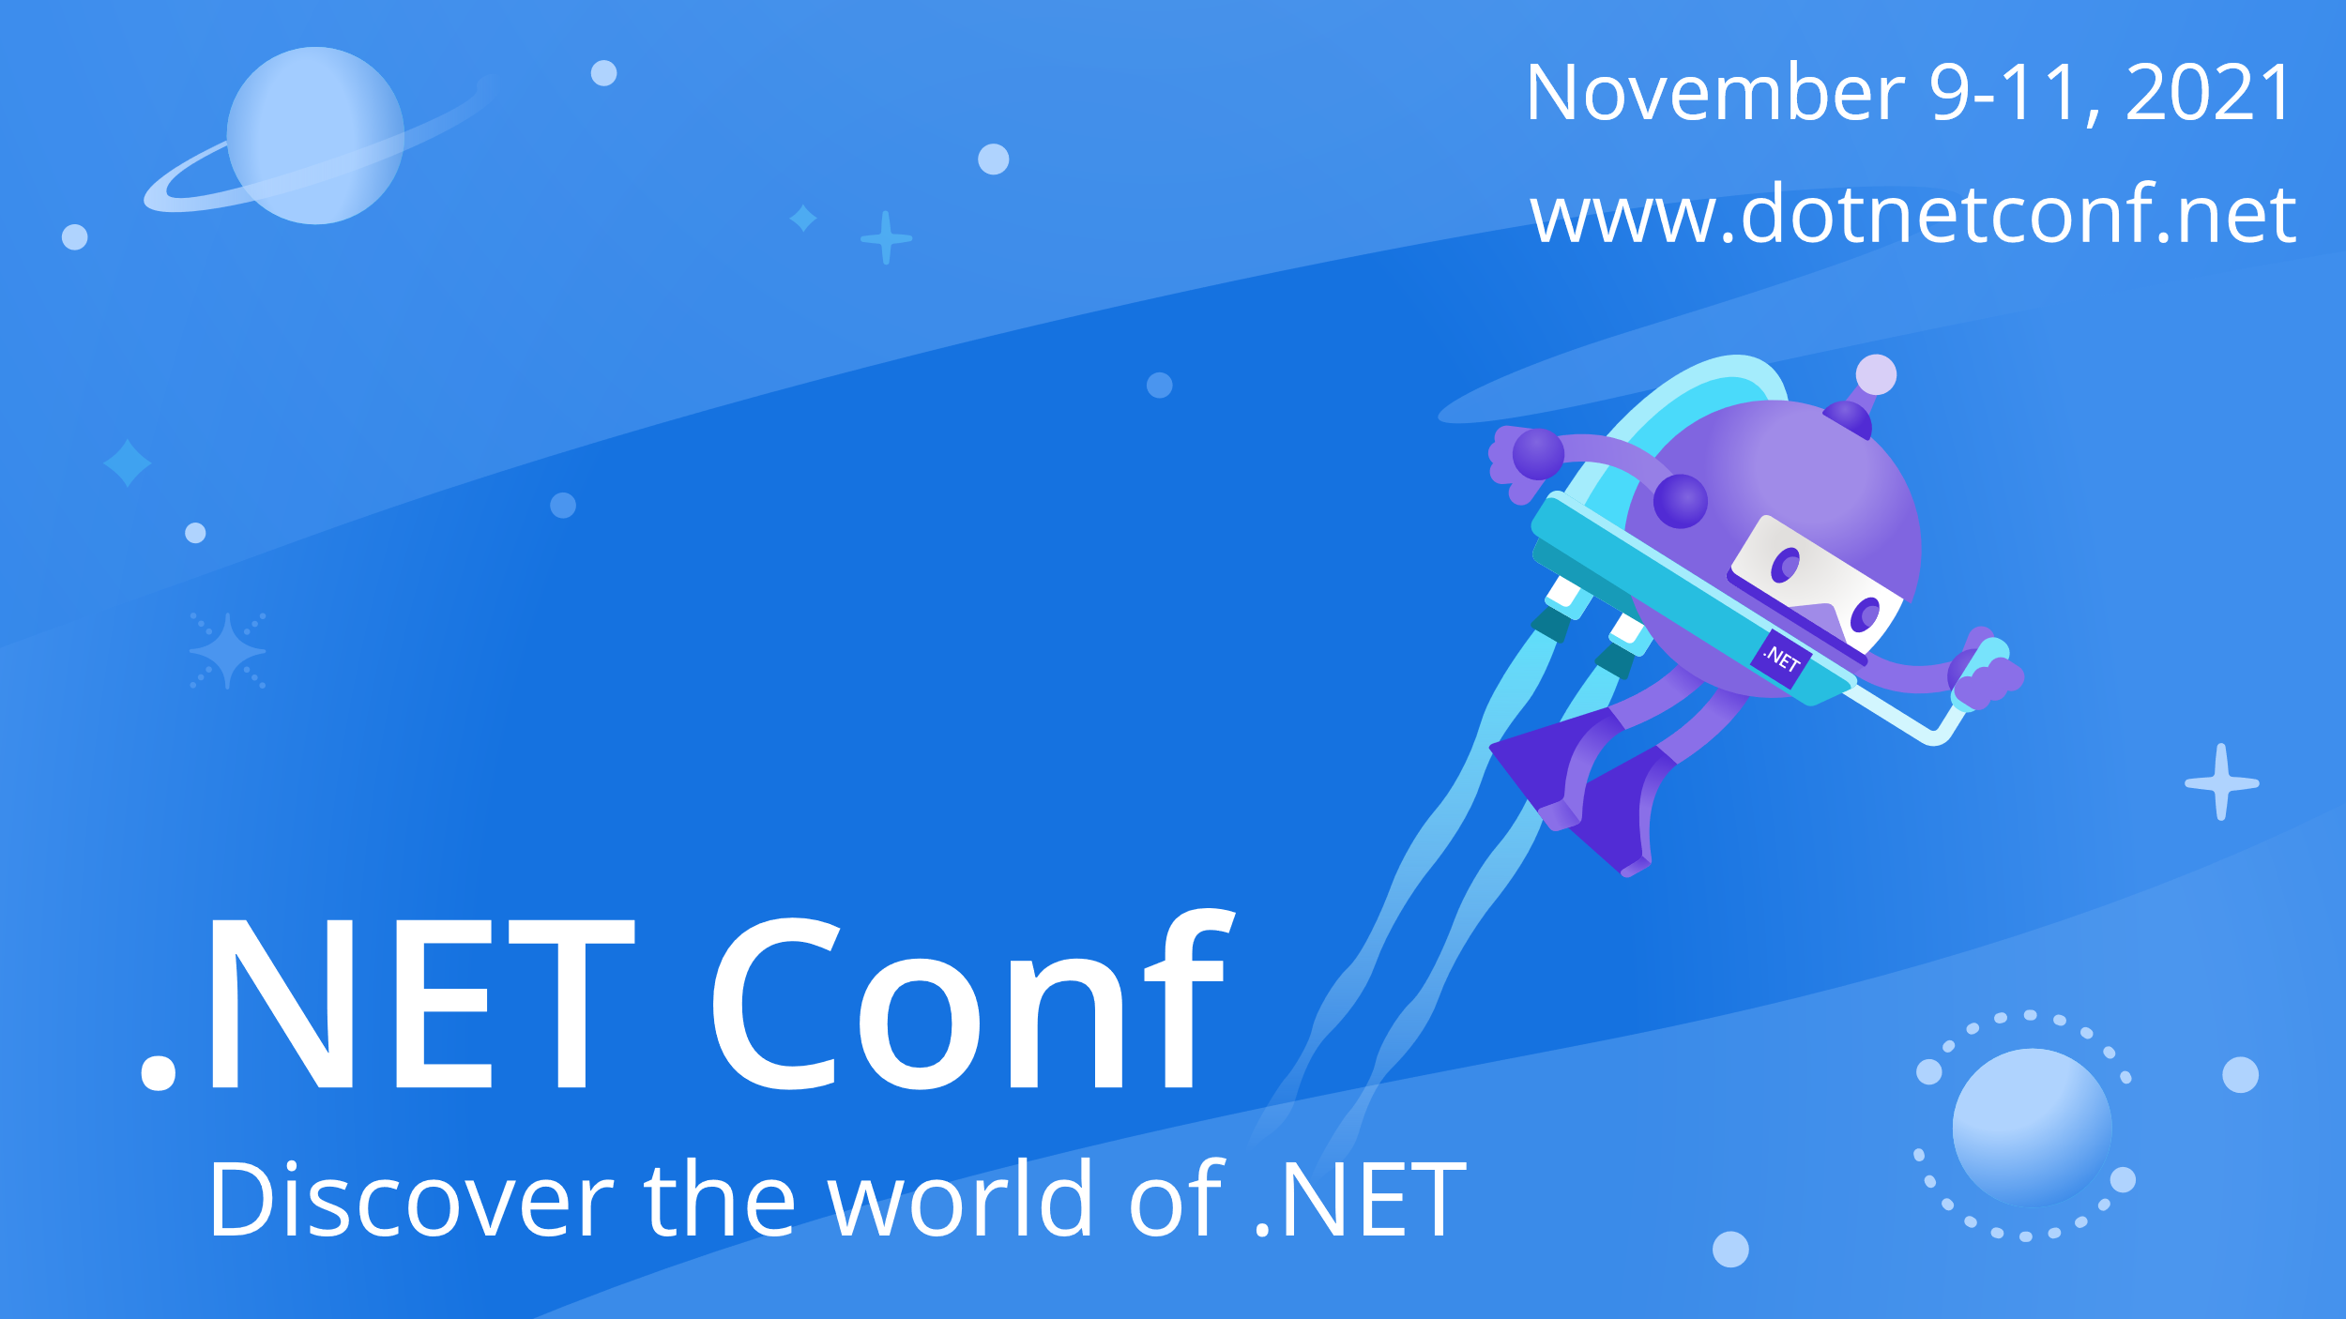

Slide 2


Machine Learning for .NET developers
Veronika Kolesnikova

Slide 3


Veronika Kolesnikova
3x Microsoft MVP AI
MS in Information Technology
3.5 years QA Experience
7+ years development experience
C#, .NET, ML, Xamarin, Java, Node.js
Hobbies: dancing, travelling, aerial yoga

Slide 4
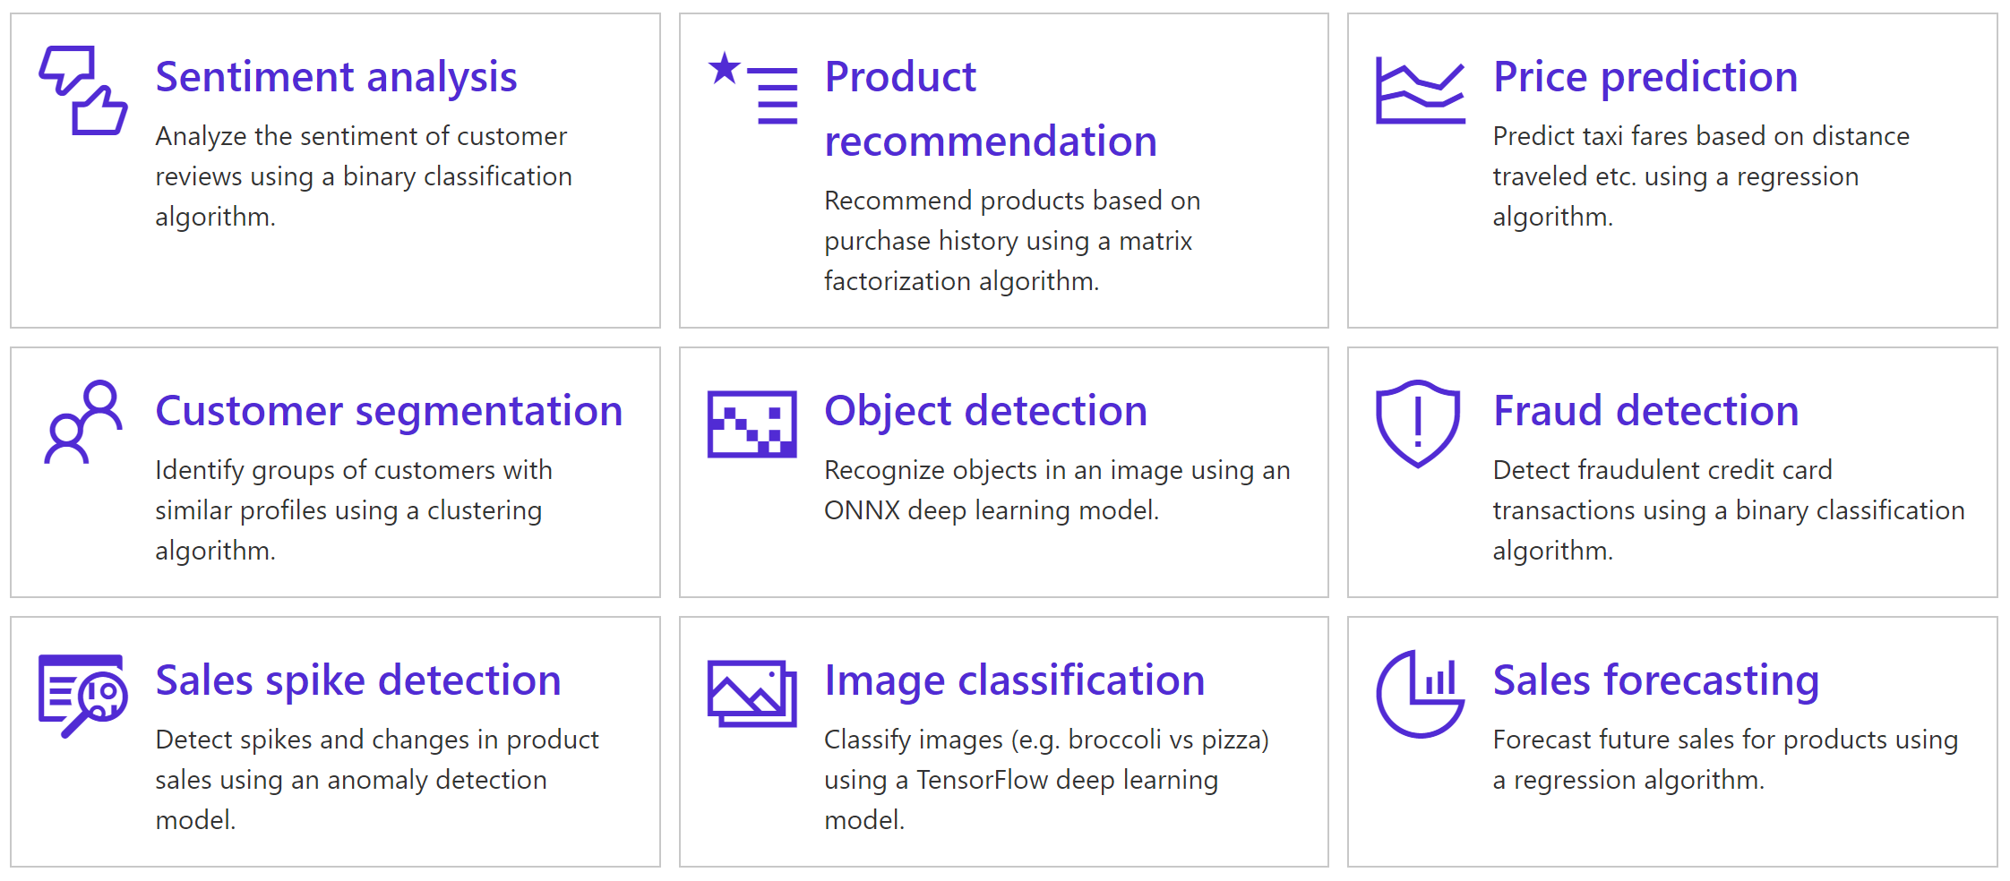
ML.NET
ML.NET allows you to train, build and ship custom machine learning models using C# or F# for scenarios such as sentiment analysis, issue classification, forecasting, recommendations and more.
github.com/dotnet/machinelearning

Slide 5
AutoML and ML.NET Model Builder
AutoML covers the complete pipeline from the raw dataset to the deployable machine learning model
Model Builder uses AutoML
UI in Visual Studio and CLI
Scenarios: Text Classification, Value Prediction, Image Classification, Recommendation, Object Detection
Limited scenarios: Anomaly Detection, Forecasting, Clustering
Notes:
***NOTE: Use this template for any text slides that appear in the presentation of the video. DO NOT use this template for any title cards.

Slide 6

Demo

Slide 7

Thanks for joining!

